Slide 1


First Things First

Slide 2
Anthony - Rob
Rob
Anthony
Cool Hair
Yeah !
Glasses
Cool Glasses
Forgot to Shave for Years !
Forgot To Shave
Hopefully has internet !
Is Awesome but has no Internet

Slide 3
Introduction to Azure Arc-Enabled Data Services
Why everything must be named Ben

Slide 4

Rob Sewell
He/Him
Bearded Consultant
Automator
Trainer
Dual MVP
Consultant Sewells Consulting Ltd
dbatoolsMoL dbachecks
ADSNotebooks PowerShell Community
Data Community
beard.media\book
@sqldbawithbeard
blog.robsewell.com

Slide 5
IMPORTANT
https://data-anz.azurewebsites.net
Mobile App
https://data-anz.sessionize.com/
Note – Session Links only live when session starts, Please use the Schedule links to join in advance

Slide 6
Why Azure Arc-Enabled Data Services?

Slide 7
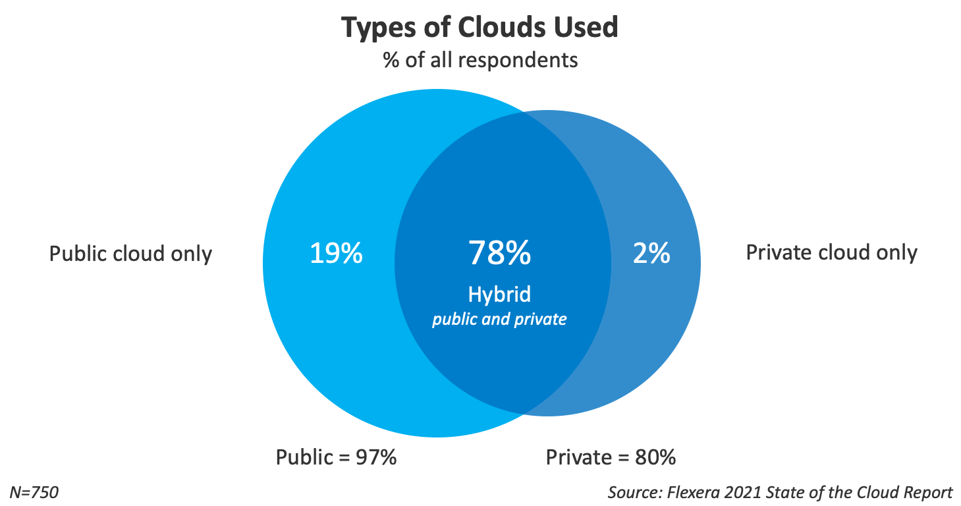

Slide 8
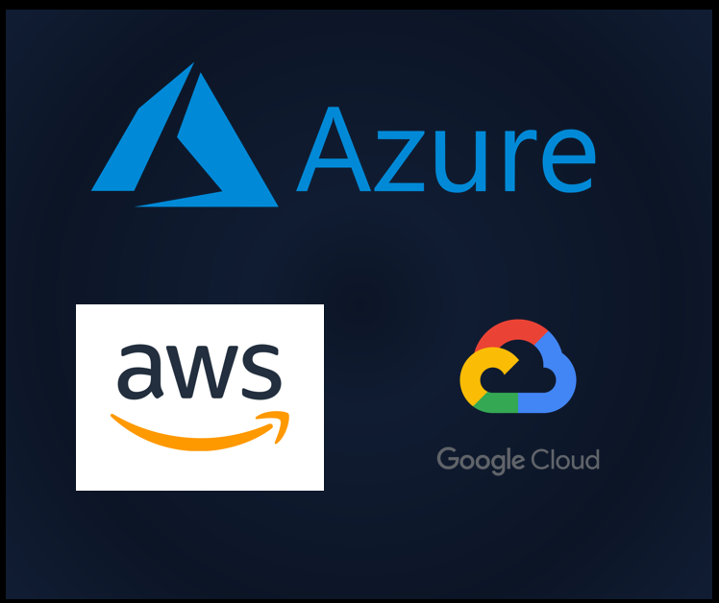

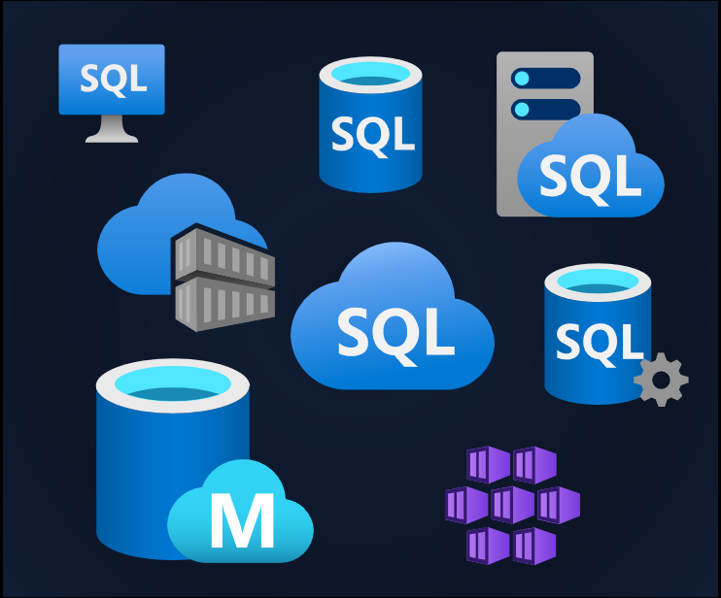
Our Services Are Everywhere

Slide 9




Data ANZ
Sponsored By

Slide 10


Management is Everywhere
Photo by Ashim D’Silva on Unsplash

Slide 11
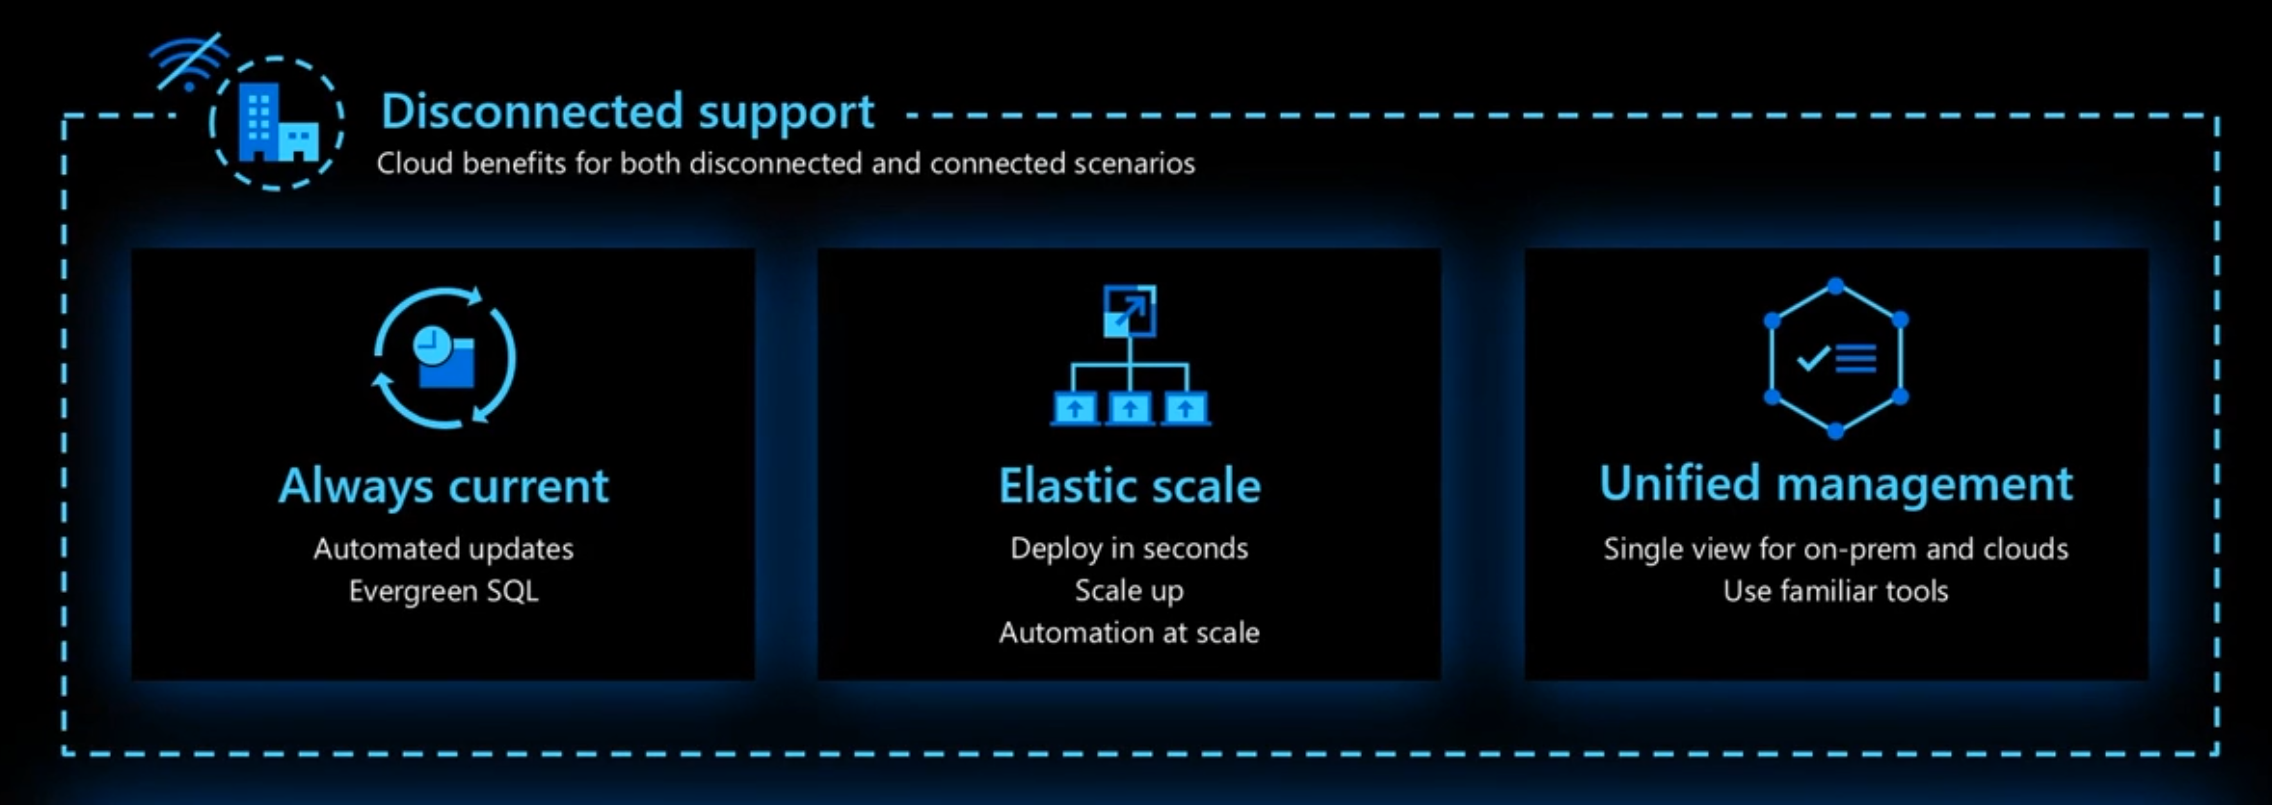

Azure Arc-Enabled Data Services Is Anywhere
Notes:
Azzure Management Services wherever your data services are
Deployments centralised
Operations, loggins, metrics, alerts – cetnralised
Inventory
Unified experience – A quick tools to find!

Slide 12

Azure Arc-Enabled Data Services Is Anywhere

Slide 13
Azure Arc-Enabled Data Services Is Anywhere

Slide 14
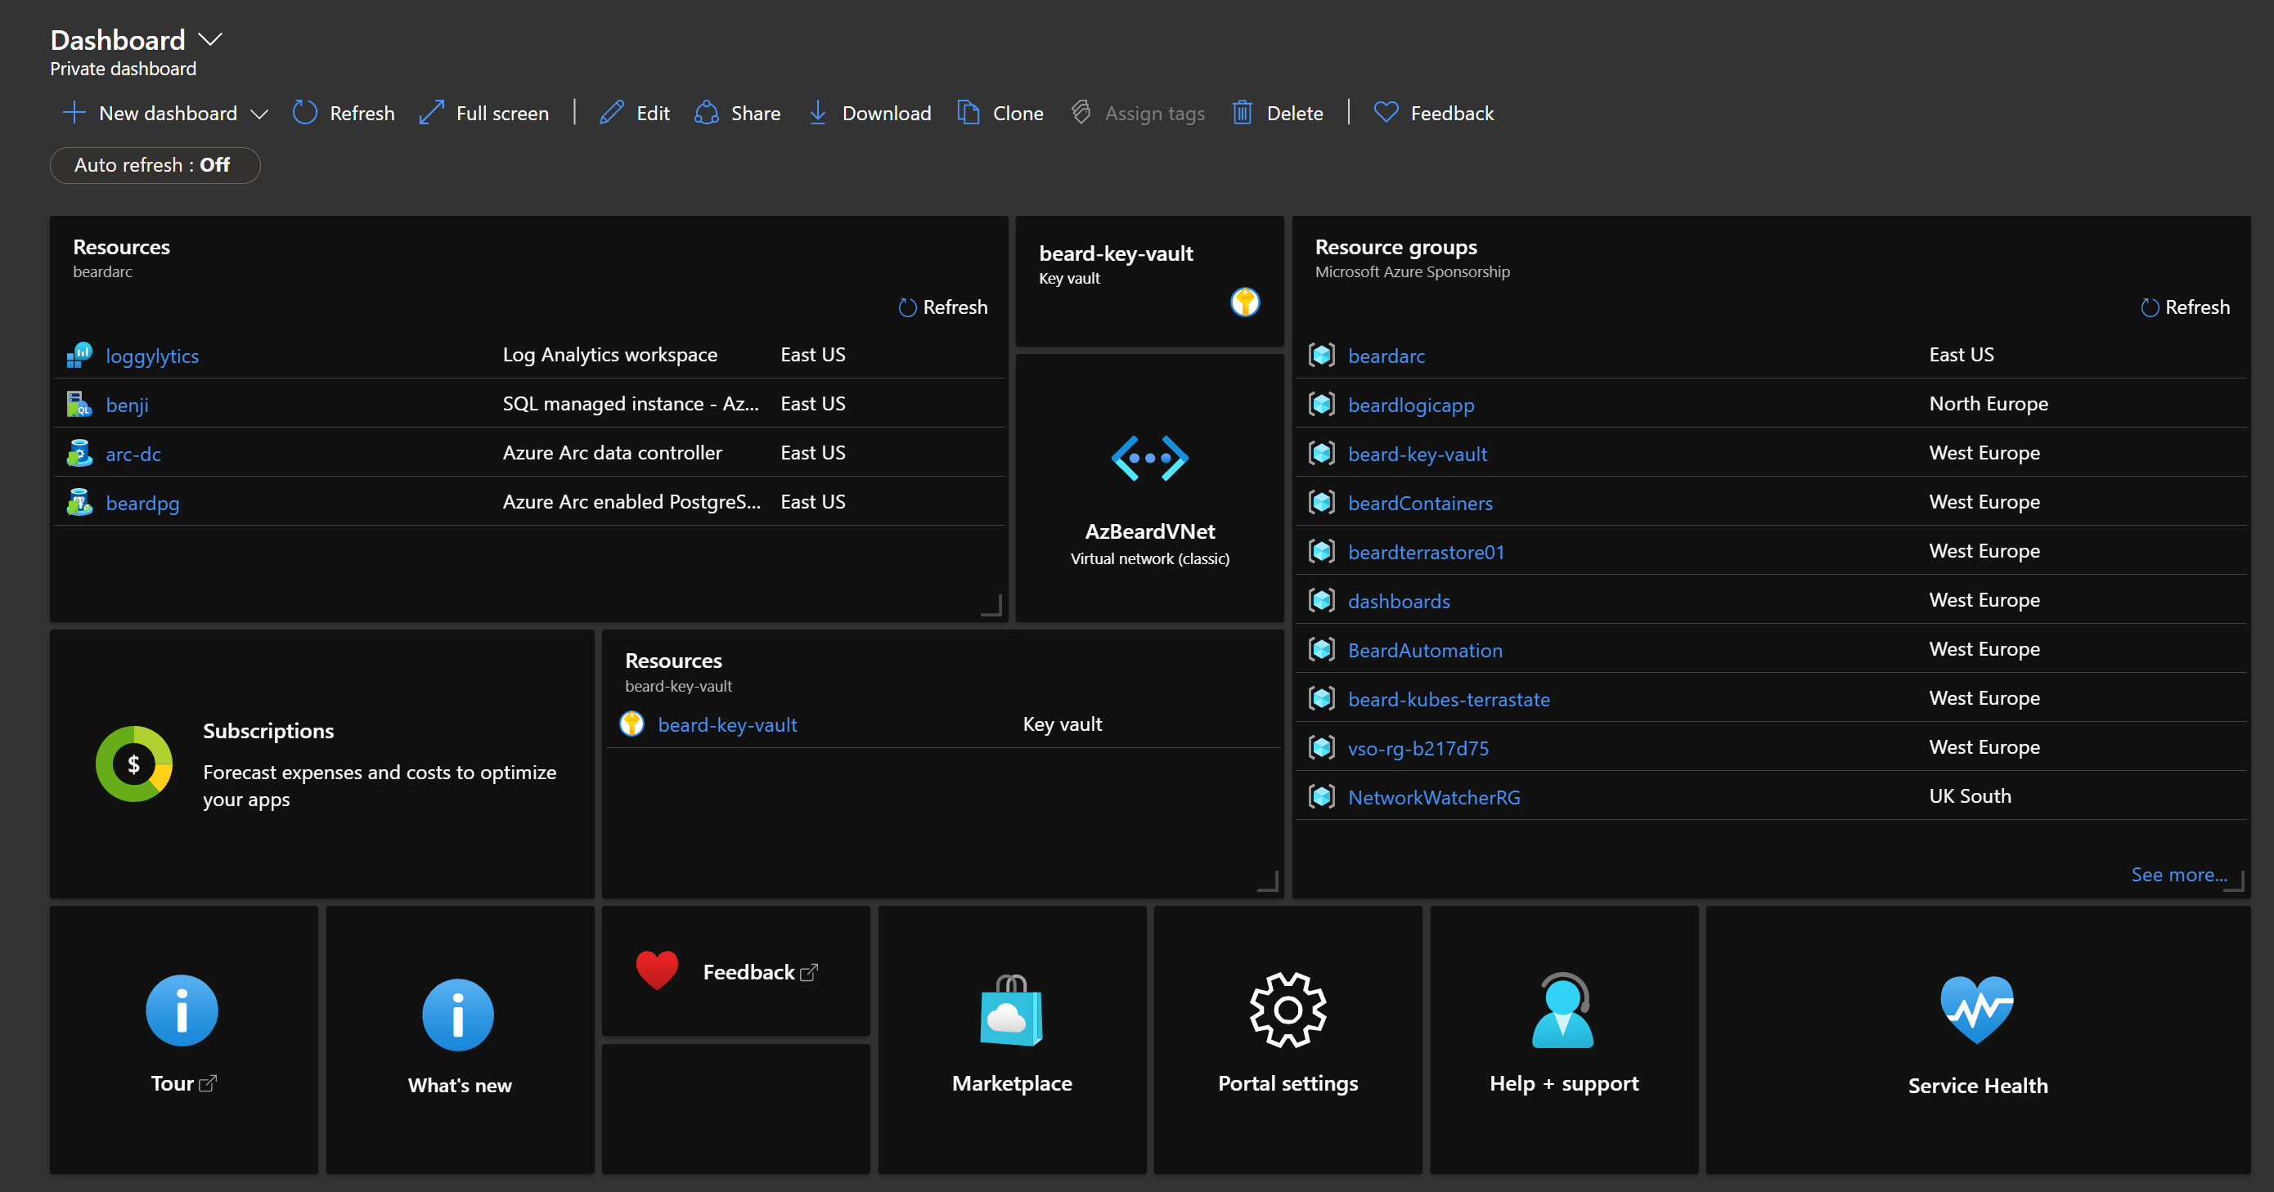
Azure Arc-Enabled Data Services Is Anywhere

Slide 15
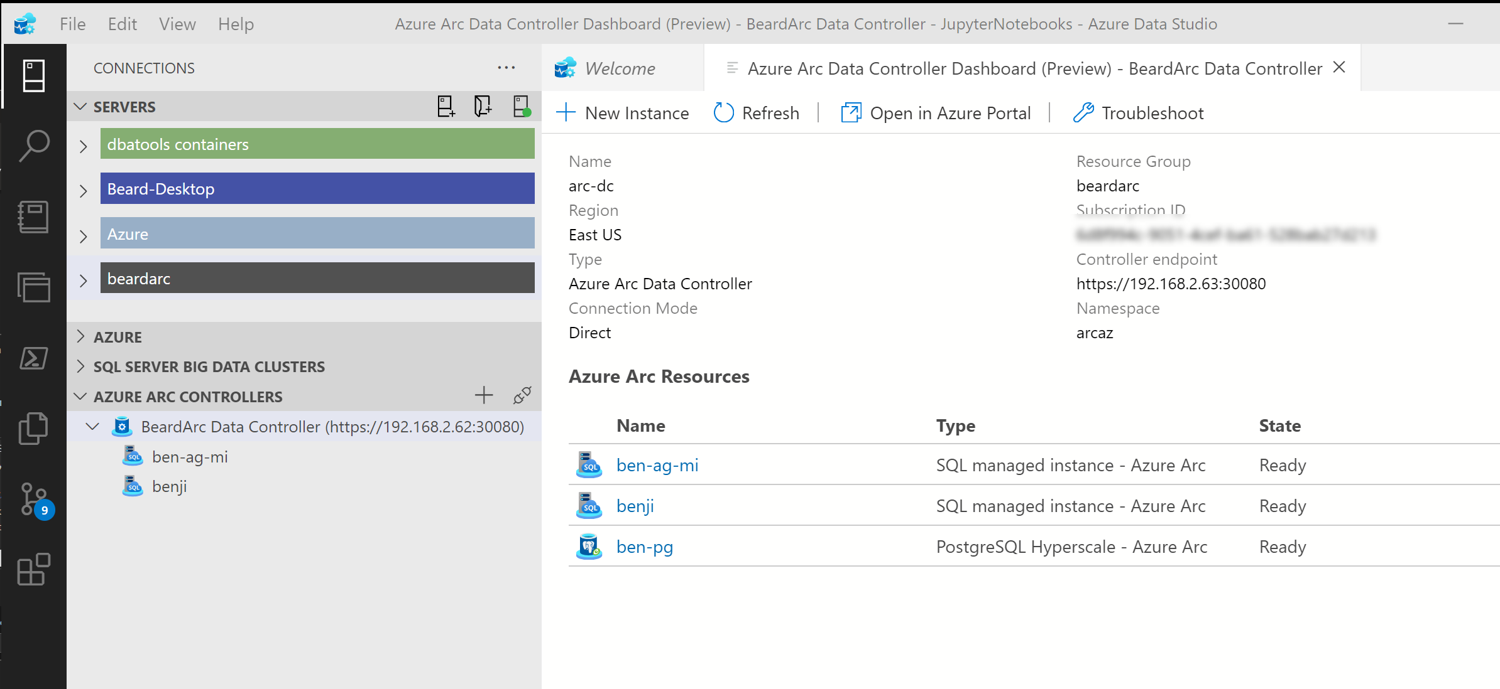
Azure Arc-Enabled Data Services Is Anywhere

Slide 16
Azure Arc-Enabled Data Services Is Anywhere

Slide 17
Important Information - continued
Prize Draws
Draws take place at 03:15 UTC and 08:35 UTC
You have to be present in the Session to win!
Join Links for the Session are in the schedule (https://data-anz.azurewebsites.net)
Sponsors
2 Dedicated time slots for Sponsors: 01:45 UTC and 05:40 UTC
Drop in for possible 1-on-1 discussions at the other open times
Join Links for the Sponsors sessions from the schedule (https://data-anz.azurewebsites.net)

Slide 18
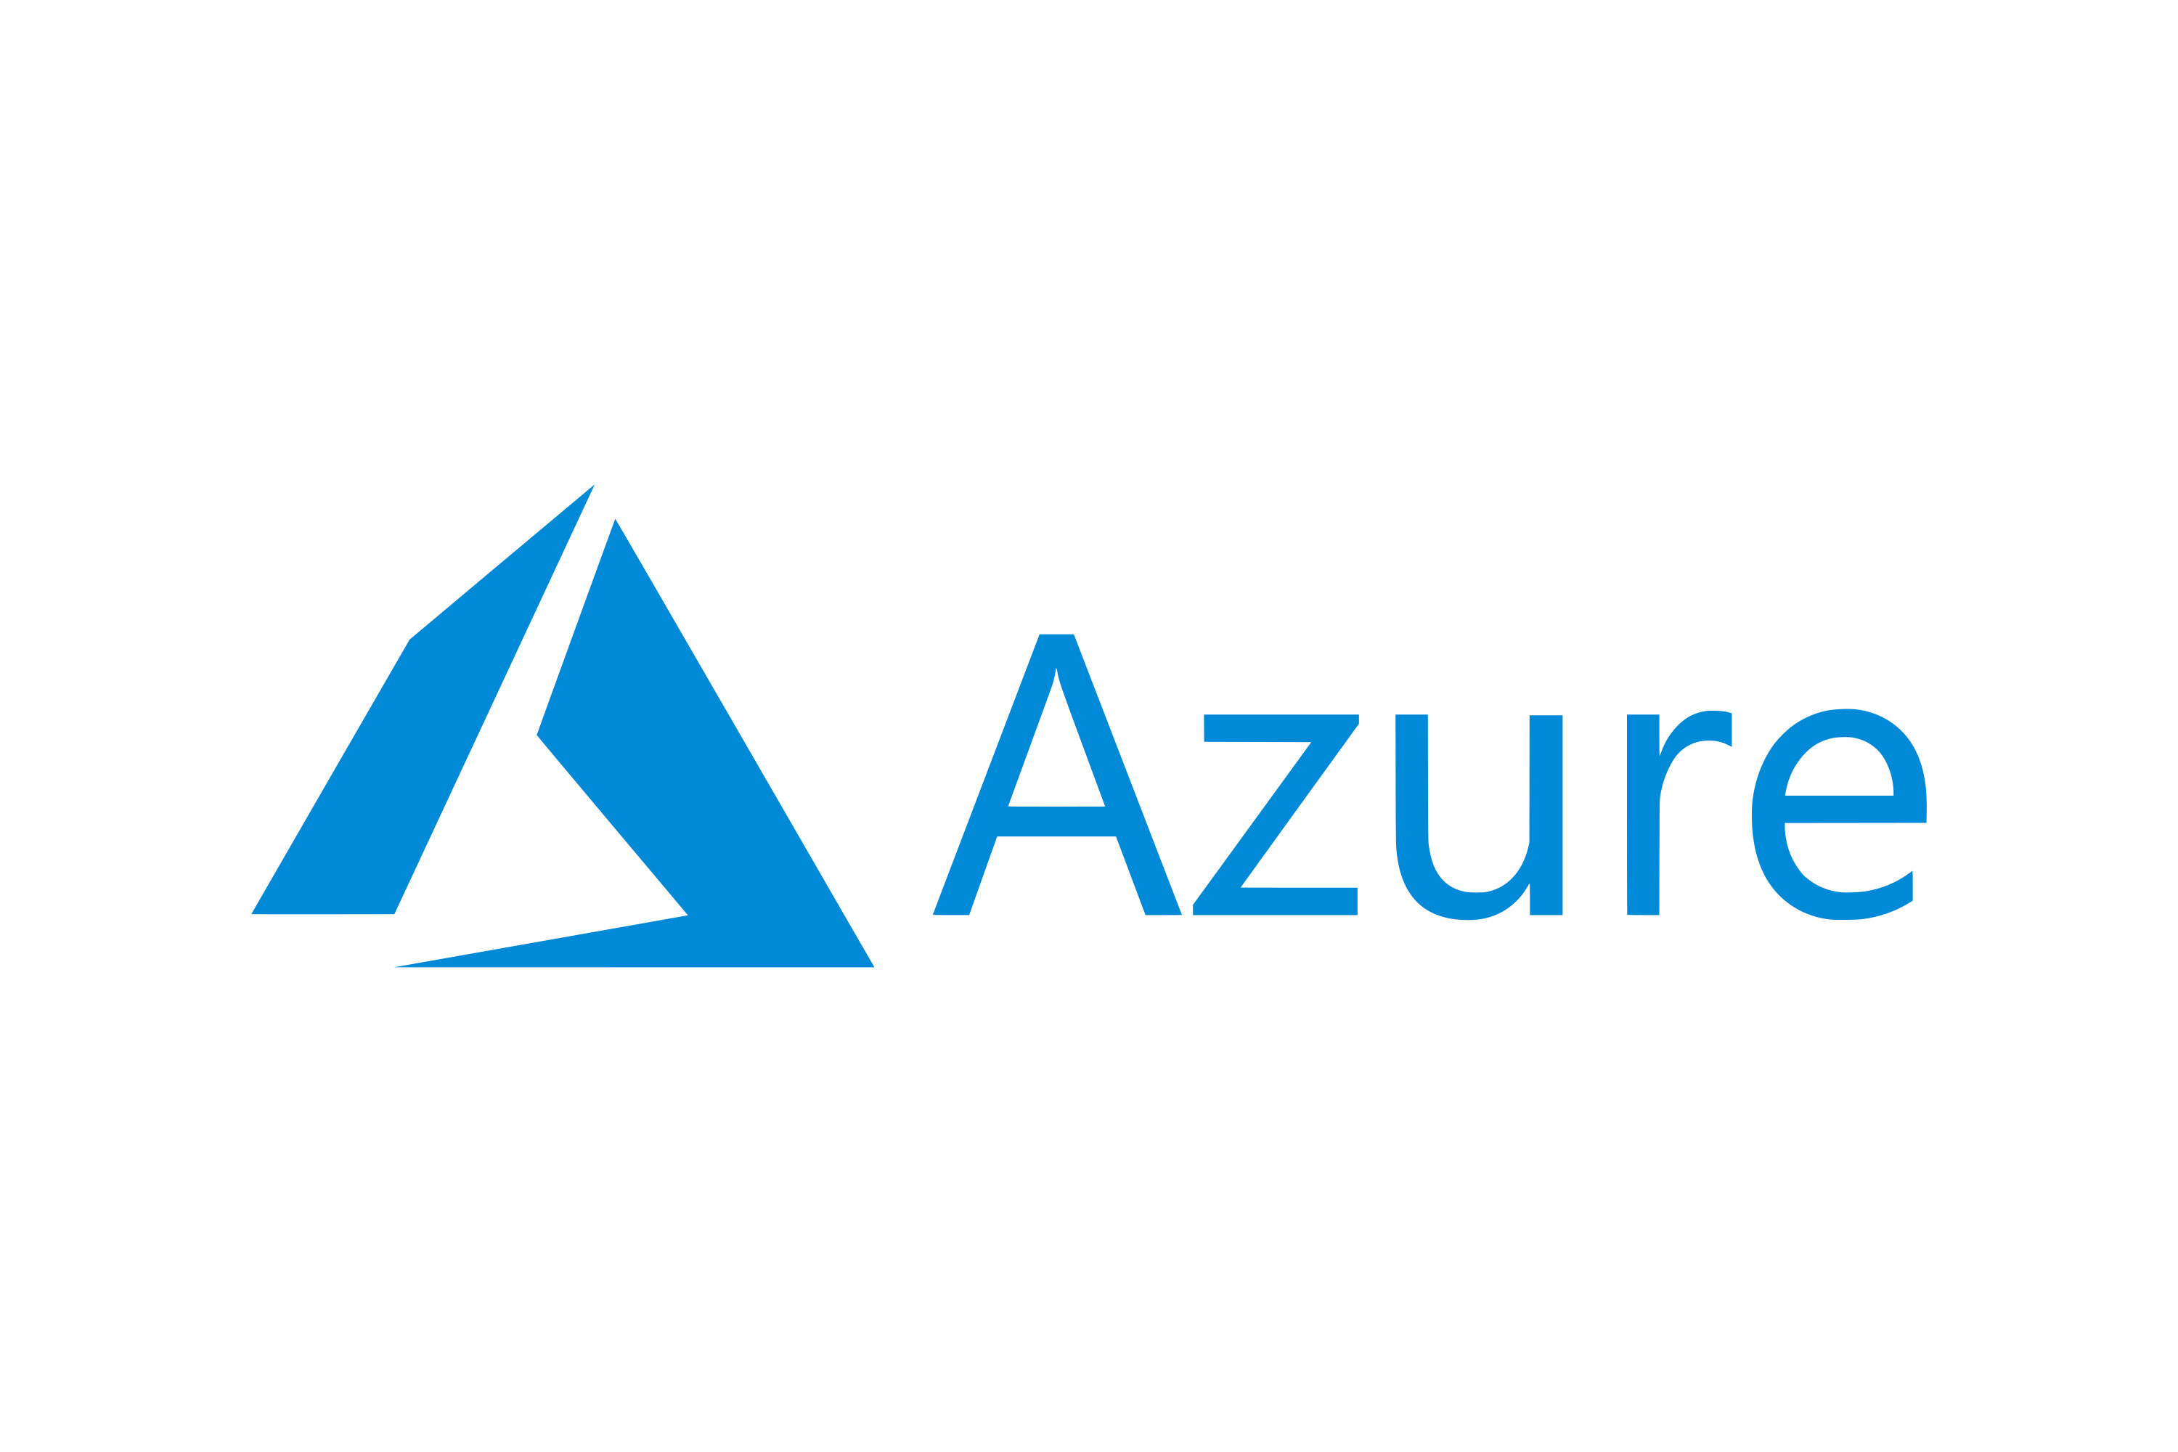







The Data Controller
Dashboards
Metrics
Logs
Backup/Restore
High Availability
Provisioning
API
Connectivity Modes
Directly Connected
Indirectly Connected
https://docs.microsoft.com/en-us/azure/azure-arc/data/connectivity
Notes:
Provides dashboards, metrics and logging built in
Controls High Availability, automated backup/restore in the plans
Enables Elastic Scale of CPU, RAM and Nodes for Availability Groups

Slide 19


Available Data Services
Azure Arc Enabled Managed Instance
Azure Arc Enabled PostgreSQL Hyperscale
Notes:
Lift and Shift version of SQL Server
Compatible with existing on-prem versions
Single Instance or Availability Group
Elastic Scaling
Open Source POstgreSQL database
Works with existing versions
v11 or v12
Self Service Provisioning using CLI,ADS, Portal, K8s
Always kept up to date (EverGreen)

Slide 20
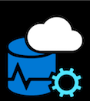


Deployment
Azure Data Studio
Azure Data CLI
Kubernetes
With more options planned

Slide 21

Storage
Kubernetes
Decouples the state of the database from the lifecycle of the pods
Persistent Storage allocated from Storage Class
Specify Storage Class for
Data
Logs
App logs
Local Storage is on the Node
Remote Storage can be anywhere

Slide 22
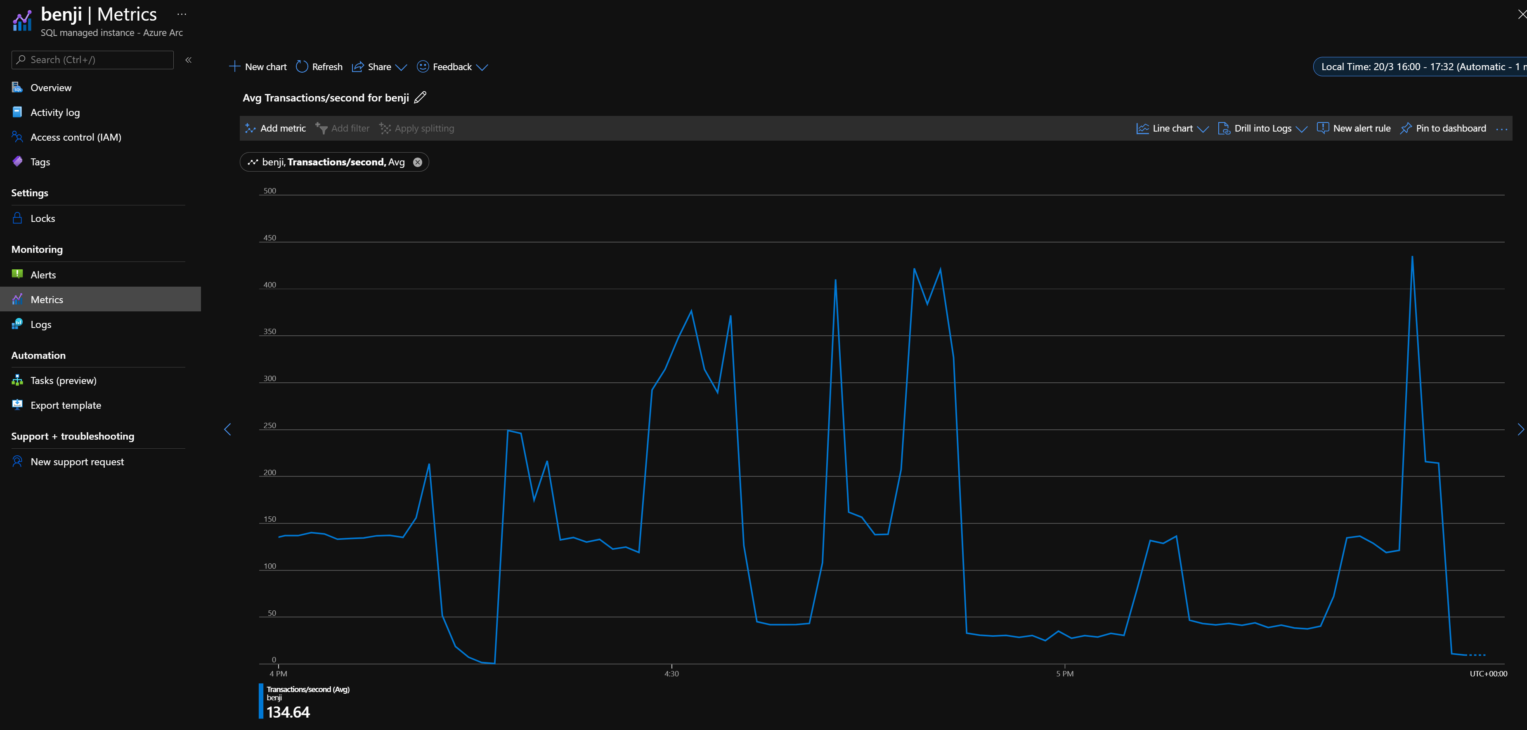
Metrics In the Portal

Slide 23
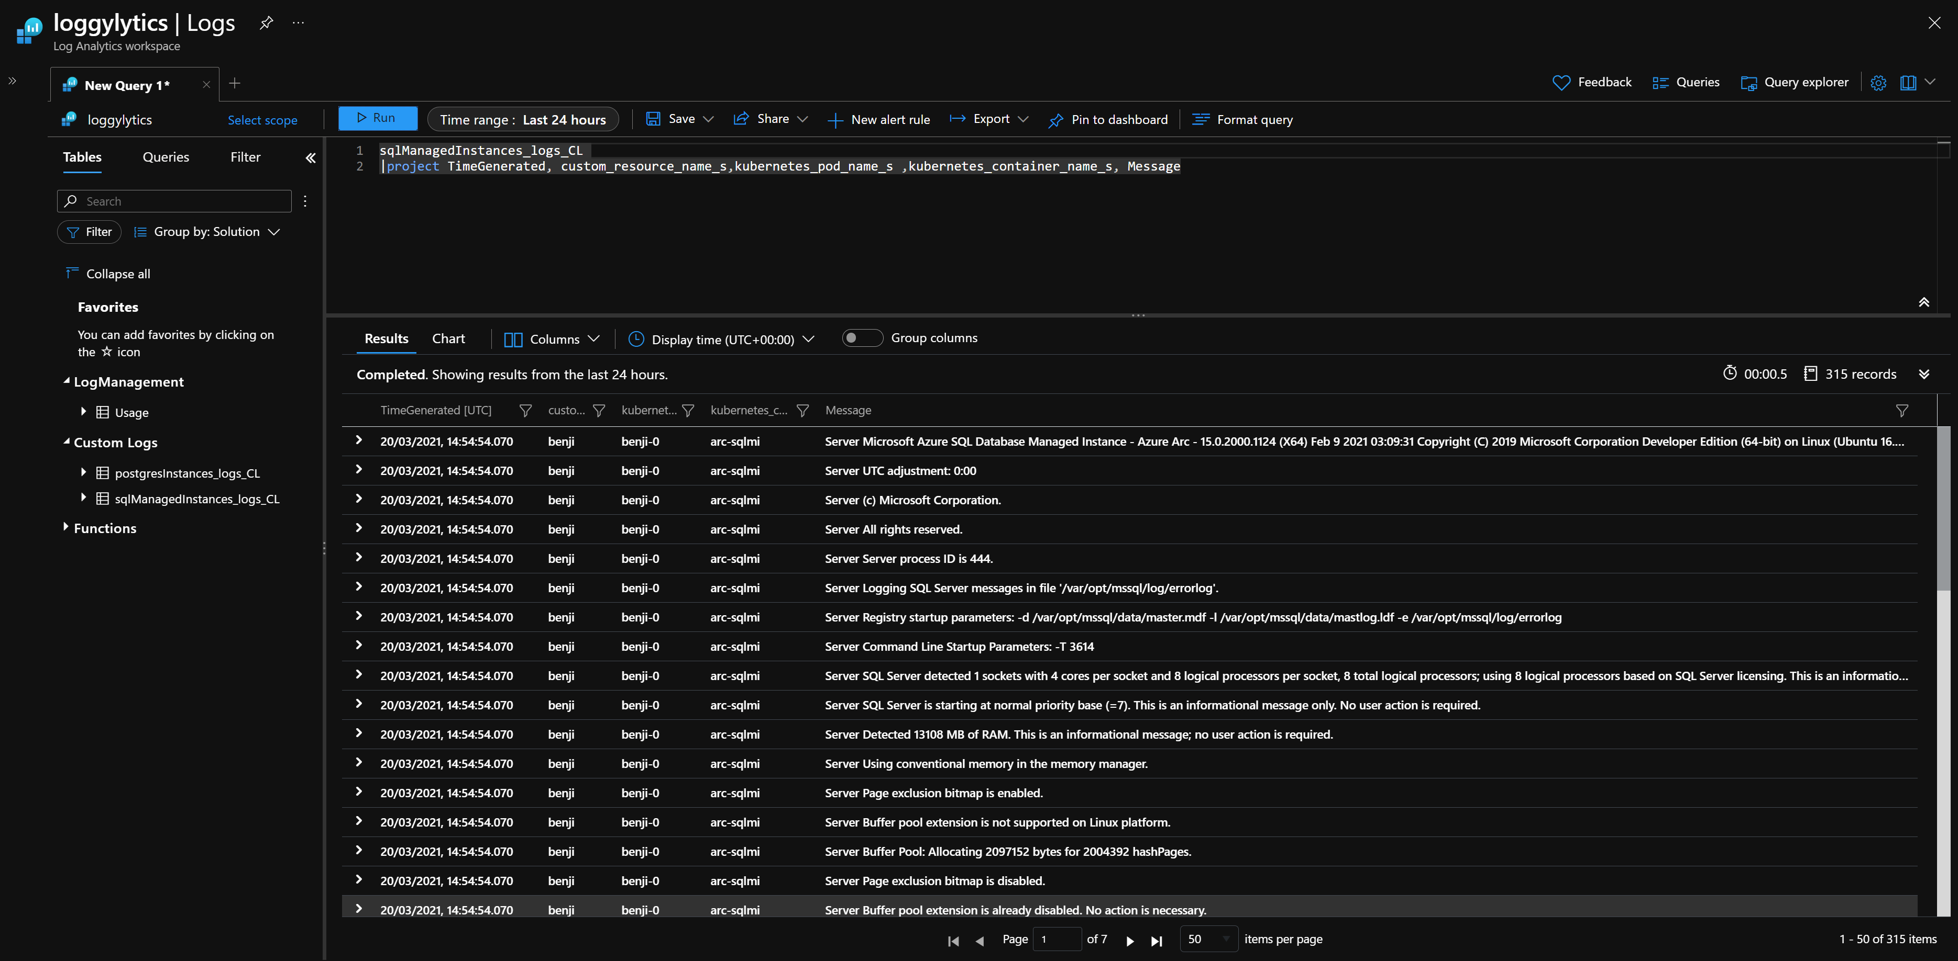
Logs In the Portal

Slide 24
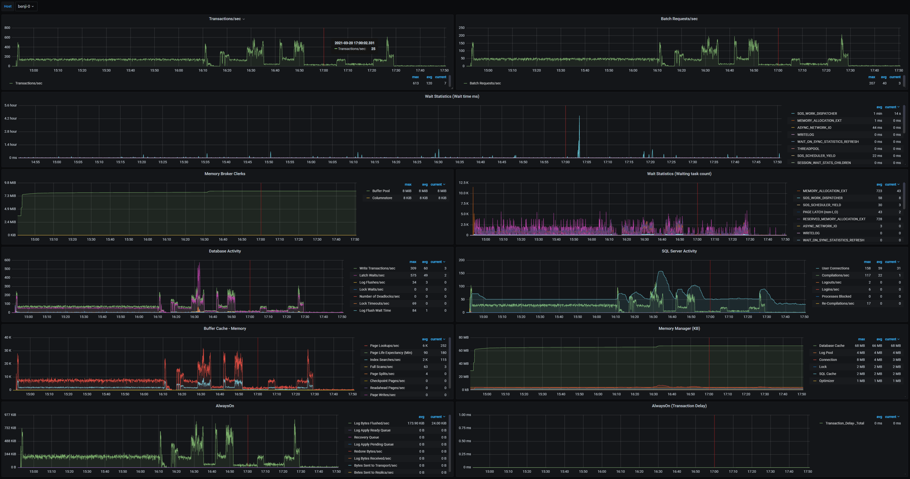
Metrics Built in

Slide 25
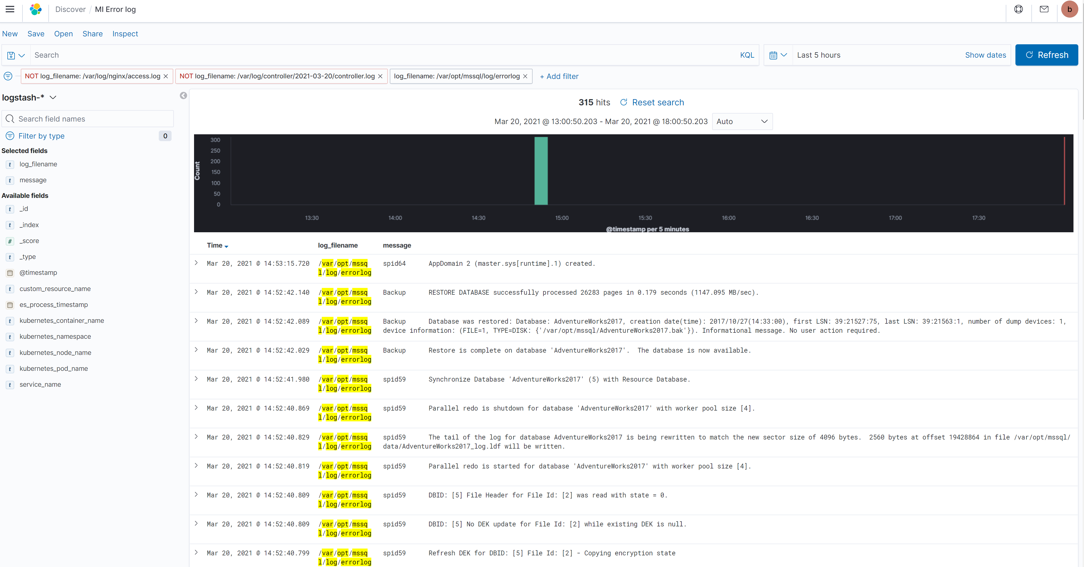
Logs Built in

Slide 26
DEMO TIME

Slide 27
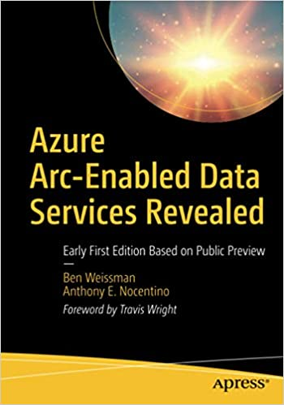
Resources for you
Azure Arc jumpstart
https://azurearcjumpstart.io
Azure Arc enabled data services
https://docs.microsoft.com/en-us/azure/azure-arc/data/
Azure Arc enabled SQL Managed Instance Overview
https://docs.microsoft.com/en-us/azure/azure-arc/data/managed-instance-overview
Azure Arc enabled PostgreSQL Hyperscale
https://docs.microsoft.com/en-us/azure/azure-arc/data/what-is-azure-arc-enabled-postgres-hyperscale
azdata reference
https://docs.microsoft.com/en-us/sql/azdata/reference/reference-azdata

Slide 28
Thank you
@sqldbawithbeard
robsewell.com
beard.media\book

Slide 29



Our Services Are Everywhere

Slide 30









Our Services Are Everywhere

